Slide 1
Growing Incredible Managers:
Business Models to Drive Innovation
Prepared by
Greg Mathers, Certified Adizes Senior Associate
June-July 2019
Projekts Nr./ CFLA līgums Nr. 1.2.2.3/16/i/001

Slide 2
You must find the right mission, vision, to correspond to your business model

Slide 3
Mutual Trust and Respect
Mission,
Vision
&
Values
Process
People
Notes:
33

Slide 4
Typical mistakes when making a Mission Statement:
Generic – can apply to any organization
Created for PR purposes
Not time bound/stagnant
Does not provide focus and thus energy
Creating the Mission without proper context
Not getting the buy in of the management team

Slide 5
Purpose of Mission Statement:
Align the management team around a common long term interest (increasing trust)
Provide managers a chance to sit in the seat of others, look at the situation from the CEO perspective (increasing respect)
Energize and focus the management team
Provide an opportunity to reevaluate the business model
Define what needs to be CHANGED

Slide 6

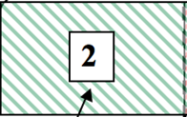
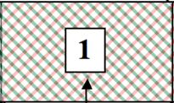
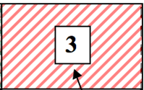

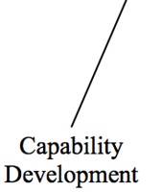
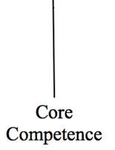

Market
Development
opportunity

Slide 7
Who Should help you create your Mission Statement?
Direct reports + additional people from:
-Finance
-R+D
-Marketing
-H.R. Development

Slide 8
Information Gathering Teams
Client needs
Competition
Capabilities
Environment
Values

Slide 9
A Mission Statement has the following components:
We are in the business of _____________ and our purpose is _____________
We foresee the following changes happening externally and internally:_____________________
These changes mean _______________ to us
Based on what is happening and how it will affect us we need to _______________
We will accomplish these changes while developing the values of ________ dropping the values of _______ and keeping the values of _______

Slide 10
WE ARE– “We are in the business of serving (needs) We do this with (capabilities) … and our purpose is…”
Who do we serve? Who are the clients/customers/stakeholders? And what are their needs? Which needs do we serve? Which needs do we not serve? (Want/Should)

Slide 11
Example A- For GM, are the dealers the clients or the drivers who buy the cars? Whom do you want to focus on, whose needs do you want to maximize and whose needs do you want to satisfice?
Example B- In a research hospital the clients are the doctors doing the research, in a teaching hospital the students are the clients and in a normal hospital the patients are the clients.

Slide 12
Example C – Google. Who are their clients? The users or the advertisers?
Example D – Car component manufactures. Who are their clients? The people who buy the component (GM, Ford), the dealer, the end purchaser of the car or the car mechanic that will fix the car.

Slide 13
WE ARE– “We are in the business of serving (needs) We do this with (capabilities) , and in light of this our value proposition is… and our purpose is…”
Who do we serve? Who are the clients/customers/stakeholders? And what are their needs? Which needs do we serve? Which needs do we not serve? (Want/Should)
Why are we doing what we are doing? For what purpose? How do we want to be remembered?
IDENTIFY ANY THREATS OR OPPORTUNITIES

Slide 14
What is a Mission Statement?
WE FORSEE THE FOLLOWING CHANGES HAPPENING EXTERNALLY AND INTERNALLY: - “We project that in the future…”
Political
Legal
Socio- Cultural
Economic
Physical
Technology
Competition
IDENTIFY ANY THREATS OR OPPORTUNITIES

Slide 15
THESE CHANGES MEAN _______________ TO US – These are the possible effects our changing environment will have on us. “These environmental changes result in…”
THESE ARE THE THREATS OR OPPORTUNITIES

Slide 16
BASED ON WHAT IS HAPPENING AND HOW IT WILL AFFECT US WE NEED TO _______________
– These are the actions we feel we will need to take in order to deal with our changing environment.
“In light of our unique capabilities coupled with the need to address critical internal and environmental factors, over the next “X” years, it is imperative that we….”
-How far forward should the Mission Statement look? (what is the “X”?)
-How often should we revisit the Mission Statement?

Slide 17
WE WILL ACOMPLISH THIS WHILE DEVELOPING THE VALUES OF ________ DROPPING THE VALUES OF _______ AND KEEPING THE VALUES OF _______
The core beliefs that we do not want to violate when implementing our Call For Action.
“We will fulfill this mission while developing our … dropping our ... and maintaining our ….”

Slide 18
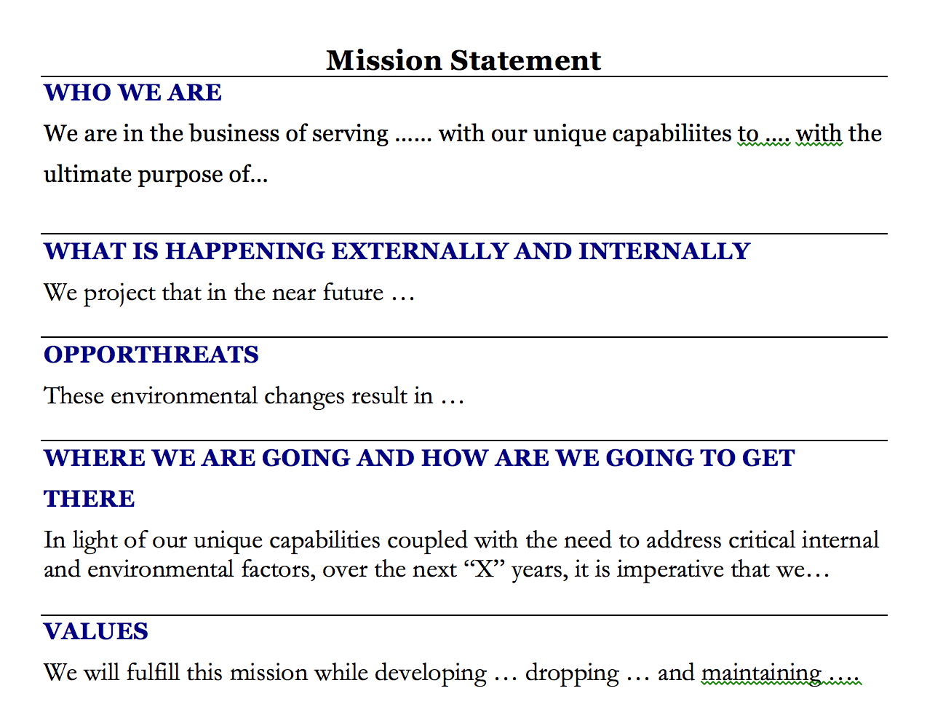
What is a Mission Statement?

Slide 19
How to communicate the Mission to the rest of the org.?
If you involve your management team their participation will guarantee their awareness of the Mission.
If they are able to contribute to the discussion in an open environment, (without compromsing the authority of top management) then they will buy into the Mission.
But you can’t have the whole organization involved in the meeting, what about them?

Slide 20
Mutual Trust and Respect
Mission,
Vision
&
Values
Structure
Process
People
Notes:
2020

Slide 21
https://www.salon.com/2019/06/21/communing-with-the-dead-i-followed-the-grateful-dead-to-escape-and-ended-up-finding-home/
Thank You!
Next class discussion article

